Slide 1
THE CUSTOMER SERVICE PROCESS FOR TRAVEL AUTHORIZING OFFICIALS
YN1 Megan Lange - Call Center
CWO McElroy - Customer Service Division
Notes:
Good Morning everyone, I am CWO Wess McElroy and I will be your host for this live session. With me today I have my Executive Officer, LT Toby Sutton, The Travel Branch Chief, CWO Jen Cockram, YN1 Megan Lange from the travel section of the call center, and my incredibly talented P&D staff: Mrs. Maddy Jackson, Mrs. Sandi Cottrell, Mr. Charlie Bartocci, and Mr. Matt O’Connell.
We hope that this presentation will provide you with helpful tips and information regarding the customer service process for Travel Authorizing officials (AO’s).

Slide 2
AGENDA
AO Responsibilities
Traveler Inquiries
Status Checks
Travel Policy
Explanation of claim payment
PPC Travel Resources
Methods for contacting PPC
Notes:
In this presentation we will cover the following: (CLICK) AO Responsibilities, (CLICK) Traveler inquiries, (CLICK) Status checks, (CLICK) Travel policy sources, (CLICK) Explanation of claim payment via breakdown of a Travel Voucher Summary (TVS), (CLICK) PPC Travel Resources as outlined in ALCGPSC 033/17, and (CLICK) Methods for contacting PPC Customer Care.

Slide 3
AO RESPONSIBILITIES
& COMPLIANCE
FEDERAL AND JOINT TRAVEL REGULATIONS
ASSIGNMENT AND DESIGNATION
APPROVAL OF A TRAVEL CLAIM/SUPPLEMENTAL CLAIM
TRAVEL AO OFFICIAL COURSE (CG PORTAL LMS)
TRAVEL AO CHECKLIST
ADDRESSING TRAVELER INQUIRIES
ASSISTANCE WITH THE COMPLETION OF A TRAVEL CLAIM
STATUS CHECKS
Notes:
Now its time to discuss AO responsibilities and requirements to remain compliant.
(CLICK) In order to be an AO you must first be assigned and designated in writing as such. Steps for this can be found on the PPC Travel Website under the AO designation tab.
(CLICK) This is the most important part of an AO’s duties once they are designated. AO’s should thoroughly verify that all expenditures claimed are in compliance with travel policy and that they are legal and justified prior to approving a claim. Stewardship of Coast Guard funds is mandatory. Use your best judgment!
(CLICK) Currently the Travel AO training course is available in the Learning and Management system. Completion of this training may become mandatory for all AO’s very soon.
(CLICK) Use of the travel AO Checklist is required when performing your duties as an AO. This can be found on the PPC travel website.
(CLICK) AO’s should be the first point of contact for all travel related inquiries. In the following slides we will provide you with resources necessary to answer virtually anything thrown your way.
(CLICK) AO’s are required to assist in the completion of the claims, not just the approval. If necessary, AO’s should provide step by step instruction on how to complete the claim to the traveler.
(CLICK) Did you know AO’s have the ability to check the status of Claims and Supplemental Claims? In the following slides we will show you how to provide your travelers with the answers they need.
We will provide you with a lot of helpful information going forward in this presentation, all of which will prove beneficial to you, additionally all the resources you need are readily available on the Pay and Personnel Center’s Travel Web page.

Slide 4
Traveler Inquiries
Traveler related inquiries shall be addressed by the AO first at all times.
Notes:
AO’s are the Traveler’s first stop for information regarding their travel claim. It is imperative that AO’s immerse themselves in travel procedure and policy. You will be who the traveler looks to for expertise. Additionally Web TPAX navigational questions should be addressed by the AO. There are a myriad of help guides and tutorials located on the PPC Travel Website to assist you.
The member will be best served by the AO answering their travel related inquiries at the field level. PPC will always be available for emergency issues and we will cover the reasons and methods for contacting PPC later on in this presentation.

Slide 5
TRAVELER INQUIRY
Answered by the AO
What it the status of my travel claim?
What is the status of my audit?
Can you help me navigate through Web TPAX?
What is the policy regarding this particular issue?
Can you break down my travel payment?
Notes:
AO’s will be required to answer the following questions from the traveler
(CLICK) What is the status of my claim?
This includes the status of Supplemental Claims. YN1 Lange will give you information in this presentation detailing how to check the status of claims.
(CLICK) What is the status of my Audit?
Did you know if you upload all of your travel related documents into Web T-pax your audit package will be already present in the system for you? It is highly encouraged that travelers upload all documents into TPAX prior to submitting the claim to an AO. AO’s can verify that all documents are uploaded into Web T-pax and can inquire with PPC Customer Care regarding the status of an audit.
(CLICK) Can you assist me in navigating through Web TPAX?
There are numerous help guides and tutorials regarding Web TPAX located on the PPC Travel web page. This will be your lifeline for anything you may come across in Web TPAX. Your travelers will be coming to you for assistance.
(CLICK) What is the policy regarding this travel related issue?
It is the AO’s responsibility to become familiar with all travel policy to ensure he or she is approving the proper reimbursements for travel expenses, we will give you information regarding resources to become familiar with in upcoming slides.
(CLICK) Can you break down my travel payment?
In a moment YN1 Lange will give you in depth information regarding how to explain a Travel Voucher Summary. Your travelers will be coming to you for explanation so please pay close attention.
if the AO hits a wall and cant answer any of these, he or she shall submit a PPC Customer Care ticket requesting assistance with the question. In the following slides, we will provide you with information on how to complete status checks, locations of policy, and instructions on how to interpret a travel voucher summary.

Slide 6
TRAVELER INQUIRY
Answered by PPC Customer Care
Debt Collection emergencies
Travel Advances emergencies
Any legitimate miscellaneous travel emergencies
Notes:
With the AO being the primary point of contact for the traveler, PPC Customer Care will answer calls from travelers regarding:
(CLICK) Debt Collection emergencies
An example of a debt collection emergency would consist of there being a travel related debt initiated for a member that may result in an unexpected financial hardship.
(CLICK) Travel Advances emergencies
An example of an emergency related to travel advances would be: if a member has departed or are within 48 hours of departure and they have not received their travel advances. Did you know members and AO’s can check the status of travel advances in Web T-PAX? Information regarding this is located under the E-learning tab on the PPC Travel web page.
(CLICK) Miscellaneous travel emergencies.
There is no straight forward definition for what constitutes a legitimate miscellaneous travel emergency. Please ensure your travelers utilize this option as a last resort. If the issue isn't deemed urgent, Customer Care may redirect the caller to the AO.
Now that we have gone over the basics regarding AO responsibilities and Traveler Inquiries, I am going to hand the floor to YN1 Lang so she can cover some important information regarding navigation in Web T-pax and some resources available to support you in the performance of your duties.

Slide 7
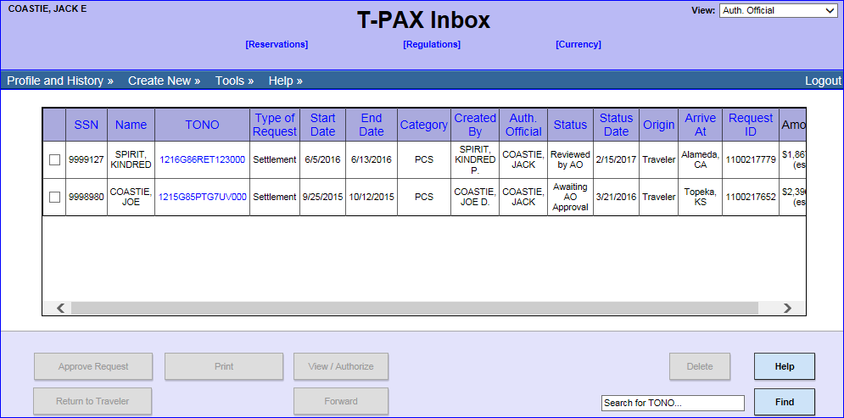
Authorizing Official View
STATUS
Notes:
The following slides will show step by step from both a Traveler and Authorizing Official View on how to check the status of a settlement in T-PAX. We begin with the AO view. From the main screen select the Profile and History drop down.

Slide 8
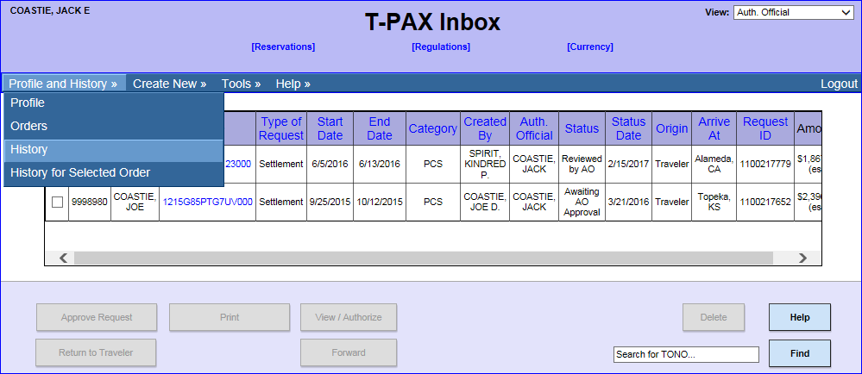
Authorizing Official View
STATUS
Notes:
From the drop down options, the AO would select History.

Slide 9
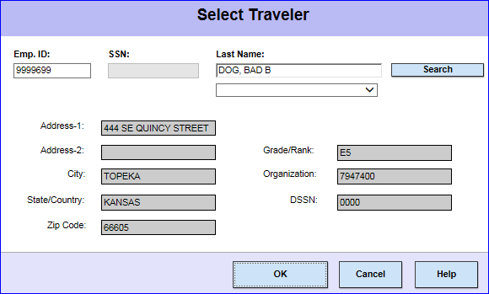
Authorizing Official View
STATUS
Notes:
The AO would next search by EMPLID, if unknown, the AO can also search by the Traveler’s Last Name. Select Search and then OK.

Slide 10
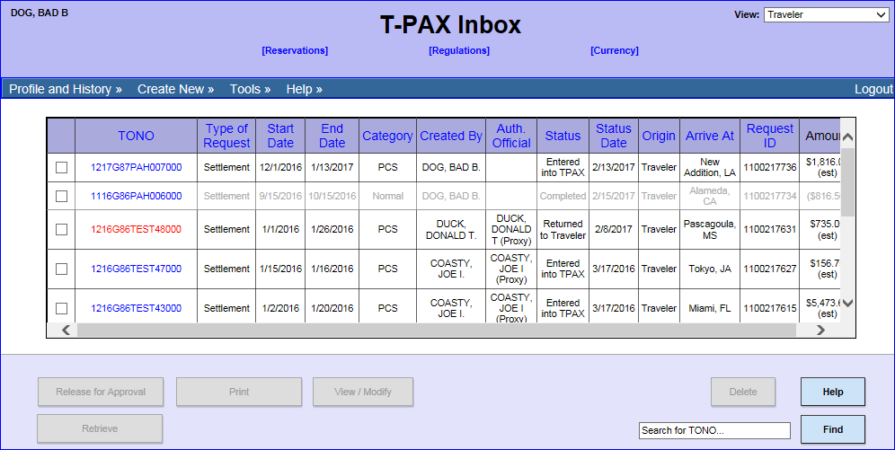
Traveler View
STATUS
Notes:
The steps to check the status of a Settlement Request, from a Traveler View include;
Once the Traveler has successfully logged into TPAX, the Traveler would select the Profile and History drop down.

Slide 11
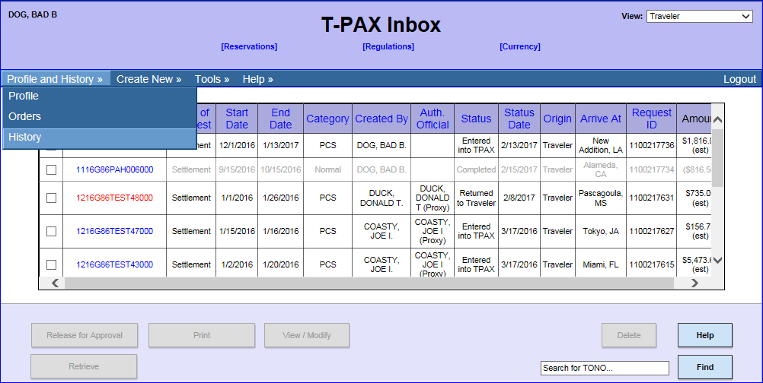
Traveler View
STATUS
Notes:
From the drop down list the Traveler would select History.

Slide 12
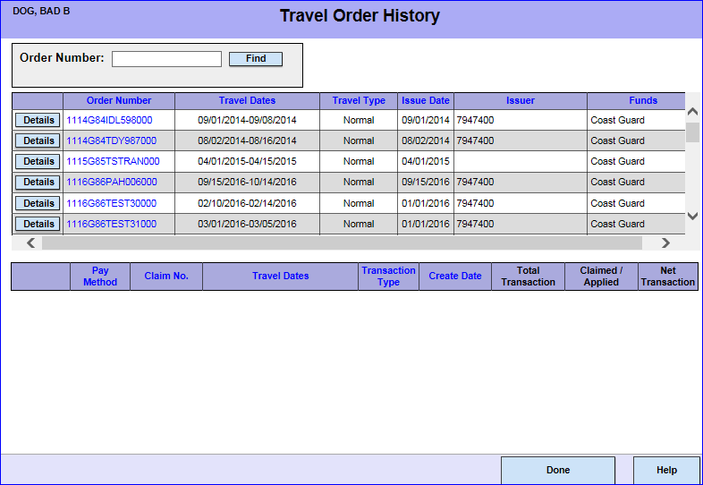
AO/Traveler View
STATUS
Notes:
The following steps will display the same for both the Traveler and the AO view. Find the Order Number of the Travel Settlement you are inquiring about. Once identified, select the Details button.

Slide 13
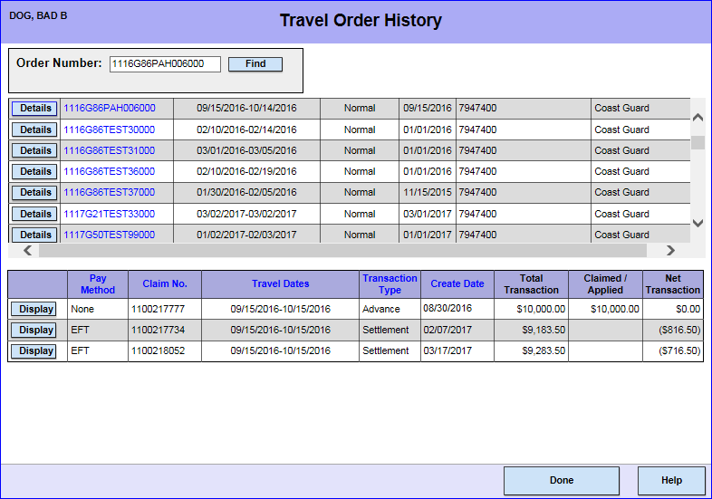
AO/Traveler View
STATUS
Notes:
Any and all transactions under the Order Number will display. In this example the Traveler has an Advance, an original settlement and a supplemental travel claim. Review each column to identify the claim number you are inquiring about and select the Display button.

Slide 14
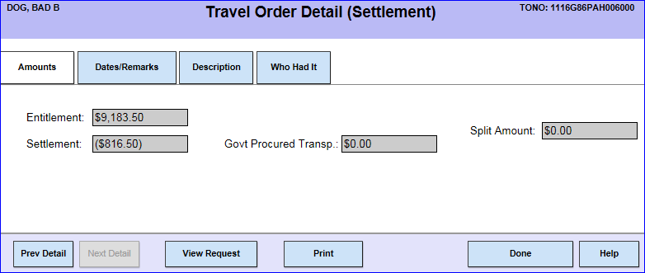
AO/Traveler View
STATUS
Notes:
The following screen will appear, Select the Who Had It tab to view the status of the claim.

Slide 15
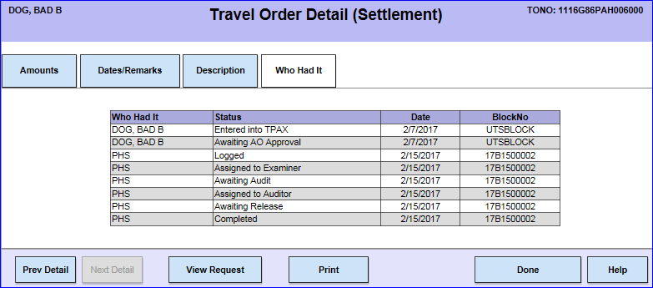
AO/Traveler View
STATUS
Notes:
This slide displays the numerous stages that a settlement request can be in, during the claim process. We will now break down what is occurring with your claim, the first stage identified is Logged. If your claim is in a Logged status, then your claim has been received by PPC and is awaiting processing. Your claim will be processed in the order it has been received. It’s important to note the three letters to the left of the Logged Status under Who Had It, those three letters identify the initials of the member in travel working on your claim. Questions that the Traveler or AO have regarding the status or any activity involving their claim should be addressed with an electronic Customer Care Ticket submission and should not be directed to the members of the travel production team.

Slide 16
AO/Traveler View
STATUS
Notes:
The next stages identified are Assigned to Examiner, Awaiting Audit, and Assigned to Auditor. Your claim at these stages, is currently being processed by the Production Team at PPC, your claim can bounce between any of these three stages multiple times before reaching the next stage in the approval process.

Slide 17
AO/Traveler View
STATUS
Notes:
The next stage for your Settlement is Awaiting Release. In this stage your claim has been processed by PPC and is awaiting release to the Finance Center.

Slide 18
AO/Traveler View
STATUS
Notes:
The final status for your Settlement is Completed. On the date the Settlement has been completed, it has been released by PPC to the Finance Center, and from the Finance Center your payment will be processed.

Slide 19
TRAVEL POLICY
Joint Travel Regulations (JTR)
Coast Guard Supplement to the JTR
Civilian Employees - Federal Travel Regulations (FTR)
Personnel and Pay Procedures Manual (3PM), PPCINST M1000.2 (series)
USCG Conference Guidance
Notes:
The following is a list of Travel Policy Resources, which are have been hyperlinked to better assist you. A multitude of additional travel policy resources can be found on PPC’s Travel Website under the Forms and Publications Tab.

Slide 20
Printing a Travel Voucher Summary
Explanation of Travel Payment
Notes:
In the following slides we will discuss how to break down your Travel Payment by reviewing the Travel Voucher Summary. If you are unsure of how to locate and print a Travel Voucher Summary in TPAX, a step by step tutorial can be found on PPC’s Travel Website under the E-Learning Tab. This slide is also hyperlinked to the procedure guide.

Slide 21
Explanation of Travel Payment
Notes:
This is a snap shot of what a Travel Voucher Summary looks like, we will break down for you, the payment section of this document.

Slide 22
Explanation of Travel Payment
Notes:
Here is close up of the Travel Payment and Reimbursable sections of the Travel Voucher Summary
Click 1 > For Member/Employee TDY Per Diem, this calculates all the per diem identified as payable to the member.
Click 2 > Member/ Employee Transportation, calculates all approved transportation related expenses. In this example all the Approved Reimbursable Expenses are Transportation expenses and therefore total the amount listed. This may not always be the case, some Approved Reimbursable Expenses may be categorized as Reimbursables and then would be calculated in the next line of the Travel Payment.
Click 3 > Member/Employee Reimbursables, this calculates reimbursable expenses that are not flagged by TPAX as Per Diem, or Transportation Expenses. In this example the only reimbursable expense is the lodging taxes.

Slide 23
Explanation of Travel Payment
Notes:
We will continue to break down the Travel Payment Section of the Travel Voucher Summary in three parts.
Click 1 > The combined total of the three sections previously discussed will be reflected as Total Entitlement. If this sample claim was a supplemental claim, the previous amount paid would be reflected as Less Partial Payments. In this example the Settlement is the original settlement and therefore reflects zero dollars. The Total Charged to Acct. Class is the total amount charged to the Line of Accounting.
Click 2 > In this example the Traveler received a $10,000 travel advance which is reflected in the Less Travel Advances line of the travel payment.
Click 3 > In this example the total amount of the settlement was less than the travel advance the member received, which is why the Total Amount Payable is in the negative. Had the claim been settled for more than the advance the Total Amount Payable would be the remaining amount that would be owed to the Traveler. In this example the Traveler is Due US (US Government) $816.50 . Attached to the Travel Voucher Summary the Traveler would receive a debt notification letter.

Slide 24
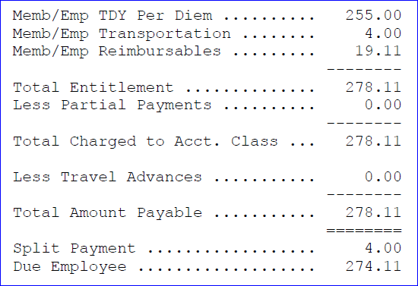
Explanation of Travel Payment
Notes:
In a separate Travel Voucher Summary when the Total Amount Payable is in the positive, The Total Amount Payable will be divided into two sections, Split Payment and Due Employee. Split Payment is the amount that you had designated in your travel claim to pay directly to your Government Travel Charge Card. Due Employee is the difference between the Total Amount Payable and the Split Payment that will be paid directly to the Traveler. This concludes our breakdown of the Travel Voucher Summary.

Slide 25
TRAVEL RESOURCES
Notes:
Here is the home page for the new Travel Branch website. Each tab within the site has been updated to provide you with the most up to date information and guides associated with travel.
Under the News tab you can find PPC’s General Announcements, Top 10 Tuesday’s Recordings, Q&A Sessions, and Travel & WEB TPAX News Updates.

Slide 26
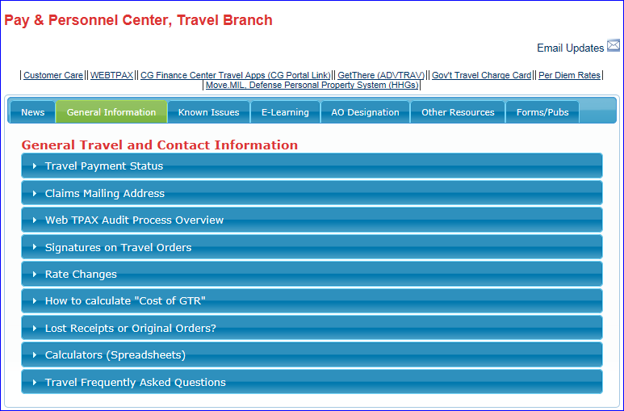
TRAVEL RESOURCES
Notes:
Clicking on the General Information tab will take you to the General Travel and Contact Information, some of the items you will find here are Mailing Addresses for your claims, information regarding lost receipts or original orders, and Travel Frequently asked Questions.

Slide 27
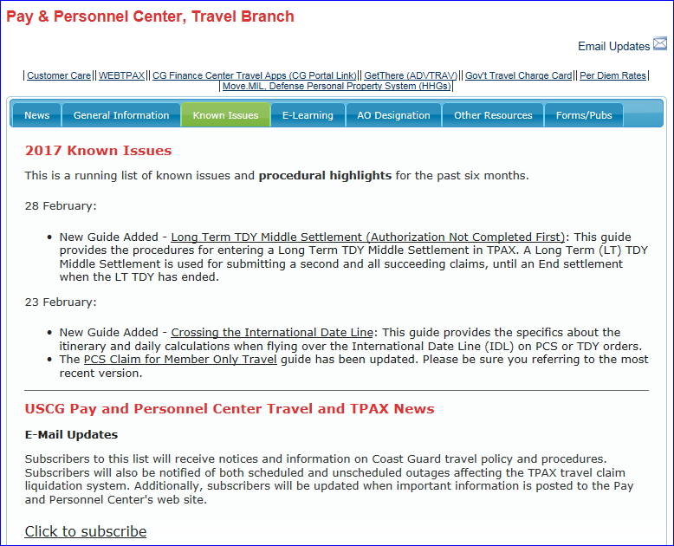
TRAVEL RESOURCES
Notes:
Next is Known Issues, this contains a running list of known issues and procedural highlights for the past six months.

Slide 28
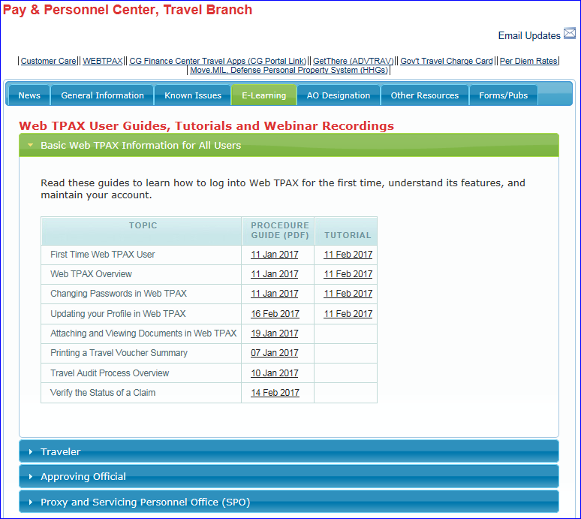
TRAVEL RESOURCES
Notes:
The E-Learning tab is the location to find the new and updated Web TPAX User Guides, Tutorials, and Webinar Recordings. The information is divided into 4 sections, the first section is Basic Web TPAX Information for All Users. Use these guides to learn how to log into WEB TPAX for the first time, understand TPAX features and maintain your account. Some Topics contain both a Procedure Guide and a Tutorial. The procedure guides are Step by Step Instructions while the Tutorials are a presentation of the same information containing a voiceover.

Slide 29
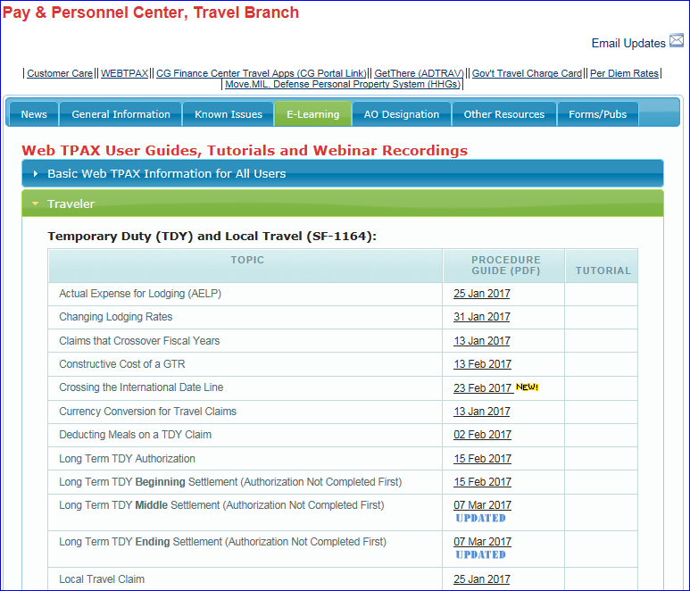
TRAVEL RESOURCES
Notes:
The second section is to assist the Traveler. Under this section you will find Procedure Guides for Temporary Duty and Local Travel, Invitational/Evacuation and Medical Travel, Audits, and Permanent Change of Station.

Slide 30
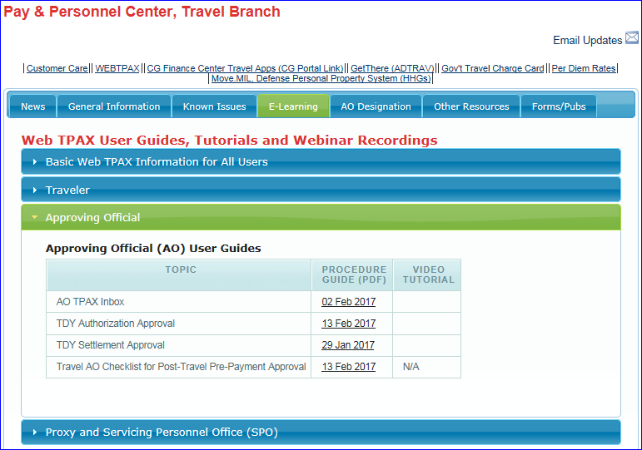
TRAVEL RESOURCES
Notes:
The third section is to assist the Approving Official. Under this section you will find Procedure Guides and the Updated Travel AO Checklist.

Slide 31
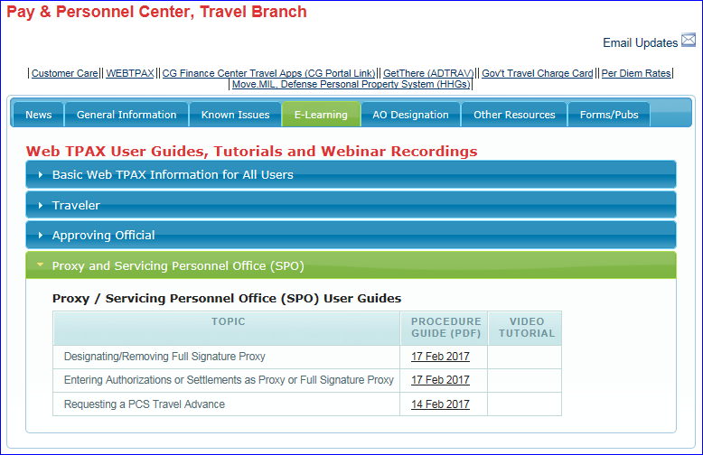
TRAVEL RESOURCES
Notes:
The final section under E-Learning is for the Proxy and Servicing Personnel Office (SPO).

Slide 32
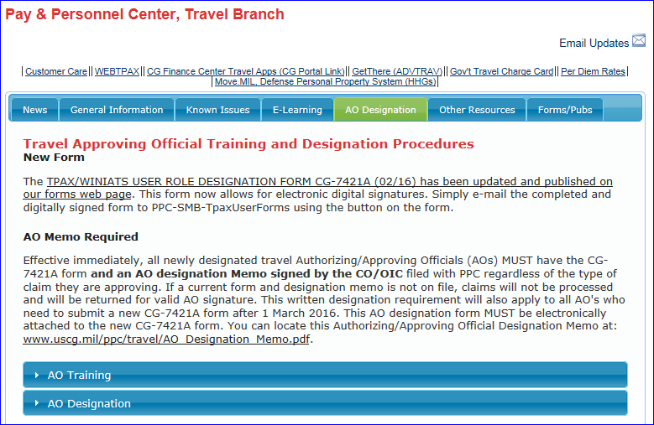
TRAVEL RESOURCES
Notes:
Next is the AO Designation tab, this tab contains the Travel Approving Official Training and Designation Procedures.

Slide 33
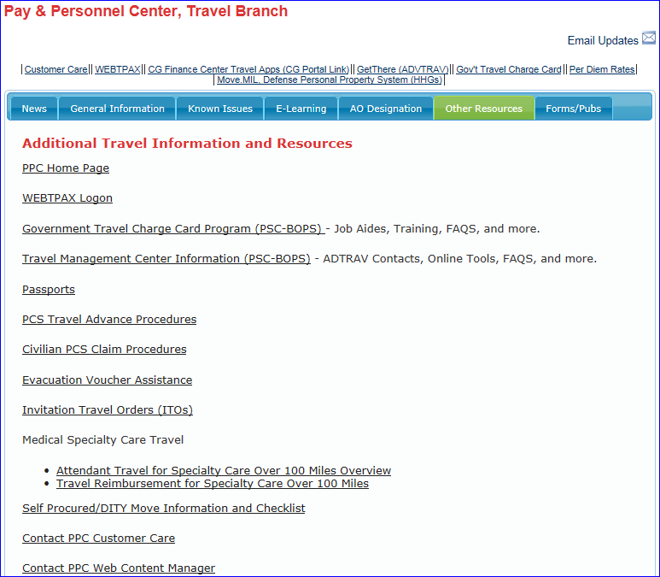
TRAVEL RESOURCES
Notes:
The Other Resources Tab is where you can find Additional Travel Information and Resources, some examples of the information you can find here is information on the Government Travel Charge Card Program, Civilian PCS Claim Procedures, Medical Specialty Care Travel, Invitational Travel, and much more.

Slide 34
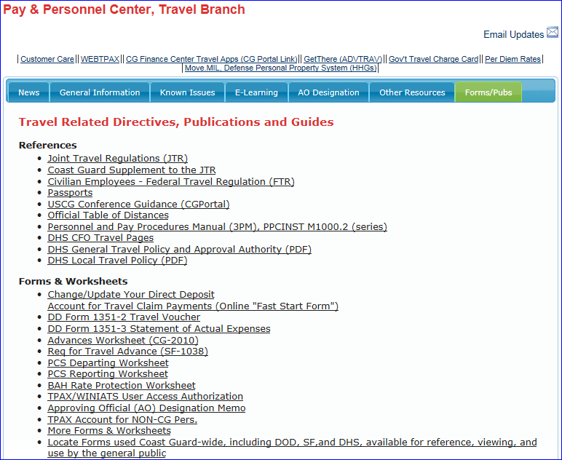
TRAVEL RESOURCES
Notes:
The final tab, Forms and Publications provides links to all Travel Related Directives, Publications and Guides.
Now that I have gone over all of this with you, I will hand it back over to CWO McElroy to go over the methods for contacting PPC Customer Care.

Slide 35
Methods for Contacting PPC Customer Care Solely Web Based Ticket Submissions from AO
Status of claim (PCS, TDY, or Supplemental)
Status of audit
Travel policy
Explanation of payment
Notes:
Thanks YN1!
Now we will go over the methods for contacting PPC Customer Care.
If an AO is contacting PPC for inquiries regarding the status of a claim or audit, policy clarification, or an explanation of a travel payment they should utilize Customer Care’s web-based ticketing system.

Slide 36
Methods for Contacting PPC Customer Care
Acceptable circumstances for calls
Web TPAX navigational assistance (AO only)
Travel emergencies (AO and traveler)
Notes:
(CLICK)Customer Care will only provide over the phone assistance to AO’s regarding Web T-PAX navigational issues. If an AO has exhausted all resources located on the PPC Travel webpage and still is having difficulties with navigation in Web T-PAX they can contact PPC Customer Care for assistance.
(CLICK) Travelers themselves and AO’s may contact PPC Customer Care for any travel emergencies listed in the previous slides, however travelers should utilize their AO as their primary resource for assistance and information.
I know we have touched on a lot of information today, however if you take away anything from this presentation please remember where your resources are located. The PPC Travel website is chocked full of useful information to assist you with your performance of duties.
Now that we have covered our bases regarding AO responsibilities, customer related inquiries, and the methods and reasoning for contacting PPC Customer Care, its time for the Q & A portion. Please let us know what you think, we have numerous subject matter specialists in the room to answer your questions.
(CLICK)

Slide 37
QUESTIONS AND ANSWERS

