Slide 1
PPC-PF-PD@USCG.MIL
FEATURING THE PPC PROCEDURES &
DEVELOPMENT
STAFF
Notes:
Slide 1 – Introduction – Mr. McElroy
Welcome everyone to the latest installment of our Top 10 Tuesday! This PPC virtual series is brought to you by the world renowned Procedures and Development staff. My name is CWO McElroy and I will be your host today as we explore the August edition for 2017. With me today are Training Specialists Charlie Bartocci, Sandra Cottrell and Madeline Jackson as well as our Business Communications Assistant Matthew O’Connell.

Slide 2
Top 10 Things You Should Know About DEBTS
Notes:
Slide 2 – Top 10 List – Mr. McElroy
Today’s list is (CLICK) the top 10 things you should know about Overpayments and Debts. This topic is very Yeoman-centered, but it can personally effect each and every member. Since this is a heated subject and we are in the last month of a hot summer, the theme this month is how to stay cool so let’s start off this presentation with a quick Poll.
How many participants currently have a debt being deducted from your pay?
(Wait) (Commentate)
This will give us a better idea of who is listening today for this sought after topic of information.

Slide 3
References
10
Coast Guard Pay Manual (Chapter 11) COMDTINST M7220.29C
Personnel & Pay Procedures Manual, PPCINST M1000.2
Notes:
Slide 3 – Mr. McElroy
Ok everyone I’m going to get the ball rolling with an easy one, number 10 for today’s presentation is References! The key references everyone needs to know about are………. (CLICK)
The First reference I want to discuss is the Pay Manual, this is an intimidating manual for some but it is chocked full of the policies that govern our day to day work. For this topic specifically Chapter 11 is where you’ll find any and everything you need to know regarding In Service Debt Collection. (CLICK)
The Second and final reference is the 3PM chapter 9, this chapter explains the ins and outs procedurally regarding In Service Debt Collection. Please note that this section was recently updated on 25 Jul 2017.
As you all know utilizing references is a critical part of doing our job, there are no short cuts to doing this right ya’ll, get in there do your research and go out and be the premier HR specialists you are! Now that I’m off my soap box I'm going to hand the floor to the man, the myth, the legend…..Mr. Charlie Bartocci. Take it away my man!

Slide 4
9
Types of Debts
Overpayment of Pay and Allowances
Travel Claims
Unliquidated Advances
Unliquidated Travel Claims
Failure to submit Travel Audit Packages
Garnishment – Involuntary (court ordered support)
Clothing & Small Store Checkage
Tuition Assistance Recoupment
NAFA/AAFES111
Notes:
Slide 4 – Charlie
Hello everyone…Number 9 on our Top 10 list…we are going to outline the Types of Debts a member may incur. Here are a few of the most common debts for a member that may require PPC to process a debt against their pay account.
(click) The number one type of debt is due to Overpayments of Pay and Allowances. Sometimes these overpayments are unavoidable due to PCS transfer. These debts are usually due to either the information not presented to the SPO timely, or timely processing the information in direct access. An example would be when a member changes dependency and the source documents are not forwarded to the SPO timely. So members, whenever your dependency changes, be sure to provide the required documents as soon as you can. For the SPOs, these overpayments occur when these documents are not processed timely in Direct Access. The result is over or underpayment of housing allowances and O’CONUS COLA.
(click) Another debt created in DA is when the Finance Center notifies PPC when members do not liquidate, or submit timely travel claims. When this happens unliquidated advances, travel claims or when a member fails to submit a required travel audit package to PPC.
(click) Garnishments…there are several types of garnishments but mostly they are Involuntary directed by court order, many are for court ordered support for dependents.
(click) When you purchase uniform items from the Uniform Distribution Center, a debt is processed to check a member pay for those items.
(click) Tuition assistance recoupments…these are created when a member fails to complete the TA process, either by failing to report course completion or when a member fails to complete a course when tuition assistance funds were used.
(click) Non-Appropriated Funds Activities and Army Air Force Exchange System…when members fail to pay their credit card debts to these agencies, the agency submits a requests for the CG for repayment from a members pay account.

Slide 5
9
Types of Debts
Private Damages
Bankruptcy
Duplicate Payments
CG Mutual Assistance
Debts to other Service Relief Society
DOD Hospital Charges
IRS Tax Levy
Damage to Government Quarters
Government Travel Card
Personnel & Pay Procedures Manual PPCINST M1000.2 (series)
Notes:
Slide 5 - Charlie
(click) Here is a list of other types of debts that may occur. You can find all the details concerning debts that are processed by PPC in Chapter 9 of the Personnel & Pay Procedures Manual.
OK…that’s all I have on type of debts…CWO McElroy is going to tell us all about debt notifications.

Slide 6
8
Notification
Notice of Overpayment
(NOO)
Notes:
Slide 6 - Mr. McElroy
Ok you’re not done with me yet folks you have to listen to my voice for another topic today……Number 8 is Debt Collection Notifications. The Notice of Overpayment or NOO is generated by PPC (MAS). MAS will provide a Notice of Overpayment (NOO) letter for each member with a debt of $1000.00 or more via email. Servicing Personnel Offices will be provided a courtesy copy for their awareness. Members with debts of $999.99 or less will be notified by a message on their Pay Slip. What does this mean for the member? It means you need to check your email daily and watch your pay slips when they come out. SPO’s this is a courtesy copy, however in my opinion it’s a better practice to be proactive vs. reactive regarding overpayments. If you do the research upon receipt of the copy prior to the member coming to you, you can save a lot of time and heartache for both parties and maybe even come up with a solution to rectify the issue.

Slide 7
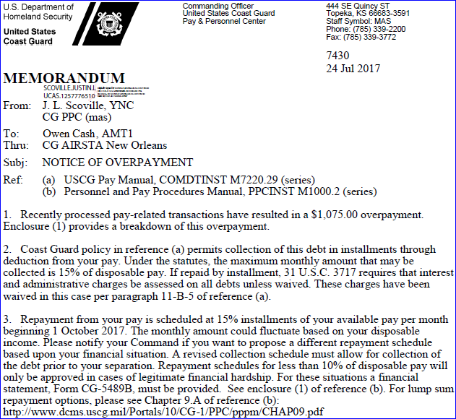
Notification
8
Notes:
Slide 7 – Mr. McElroy
(click) Here’s a sample of the Notice of Overpayment sent out by MAS. It breaks down the amount, how the debt will be liquidated and when the deductions will begin.

Slide 8
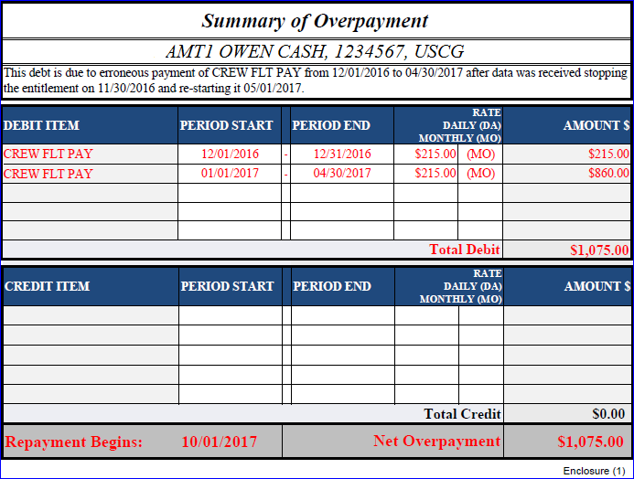
Notification
8
Notes:
Slide 8 – Mr. McElroy
(click) MAS also includes a summary of the overpayment which shows the debits and credits that resulted in the debt.

Slide 9
Notification
8
Action upon
receipt of notice
Notes:
Slide 9 – Mr. McElroy
(click) The next piece to this puzzle is what to do once you receive the NOO. Upon receipt of a Notice of Overpayment (NOO) letter the member must:
• Provide a copy of the NOO letter to their Chain of Command and their Personnel and Administration (P&A) Office.
• P&A Office counsels the member regarding the debt and the collection procedures.
This is where I hop on my soap box again, P&A offices….this is where your assistance is critical and quite frankly mandatory. You have to do the leg work on these to ensure the member has a real picture of what's going on and a way forward regarding the collection. You can phone a friend and have the SPO take a peek but sending the members to PPC Customer Care or directly to the SPO is a no go. You’re the tip of the spear so to speak, give the member a sense of confidence in the process and in you. If they are worried about a debt they aren't going to be able to focus on accomplishing the mission.
Ok I'm off my soapbox and now it’s time to hand the mic over to the soothing sounds of Mr. Matt O’Connell, the floor is yours, good Sir.

Slide 10
Waivers
vs.
Remissions
7
What’s the difference?
And
What do I want to do?
Notes:
Slide 10 – Matt
-----------------------------------------------UNMUTE------------------------------------------------------
Well, thank you, Mr. McElroy and welcome to my portion of our Top Ten Tuesday. Today, I will be covering Remissions and Waivers and the liquidation schedule for payments made.
Number 7 is Waivers and Remissions. They are not the same thing, though they are sometimes conflated in the general vernacular and this leads to some confusion.

Slide 11
Waivers
7
An act of the government to:
“Intentionally” relinquish its claim
The debt must be a result of an erroneous:
Payment
Pay and/or allowances (including Travel Allowances)
Coast Guard < $10,000.00
Defense Office of Hearings and Appeals (DOHA) > $10K
CG-5489-2
Notes:
Slide 11 – Matt
A waiver, as the screen indicates, is an act of the government to INTENTIONALLY relinquish its claim of a debt against an individual. Now, the debt must be due to an “erroneous” payment of pay or pay and allowances which includes Travel Allowances. The DHS Secretary has been granted the authority to effect a waiver up to TEN THOUSAND dollars and the Secretary in turn has delegated this authority to CG-1332.
Waivers in excess of TEN THOUSAND dollars must be submitted to DOHA or the….Defense Office of Hearings and Appeals. If you submit a debt in excess of the CG maximum amount, the Coast Guard will deny your claim and advise you to submit one to DOHA.
The form to request a waiver is the CG-5489-2 and it entitled WAIVER APPLICATION. It is fairly self-explanatory and it is submitted to the PPC, specifically MAS. It is available on the PORTAL and I’ve linked it below.
While the 3PM, Chapter 9 does cover the Waiver process, more specific information is available in Chapter 11 of the PAYMAN and I would highly recommend reviewing that chapter in detail.

Slide 12
Remission
7
The cancellation of a debt or portion of a debt
The laws governing a remission consider:
Undue Hardship
Member’s value to the Coast Guard
Injustice
CG-5489-1
Notes:
Slide 12 – Matt
This brings us to Remissions.
A Remission is the cancellation of a debt or a portion of a debt and its criteria differ from the Waiver’s specifications. It is essentially, a written request from a Coast Guard member to cancel an uncollected amount of indebtedness to the U.S. Government.
Some reasons…(and again, more detail can be found in Chapter 11 of the PAYMAN)…for a remission to be granted are:
Undue Hardship…this is when the repayment of the debt would result in a repressive financial situation for the member and would impinge upon his personal life to the point where he or she would not be able to afford the necessities of daily living.
Member’s value to the Coast Guard: The Coast Guard hard has made a major investment in its member so the deciding authority can consider the member’s performance, marks, decorations and commendations when rendering a decision.
Injustice: While the government is generally not bound by the bad advice or unauthorized acts of its representatives even when committed in the performance of their duties, the deciding authority may consider the cancelling the debts to correct obvious wrongs.
Most of these considerations fall under the rubric of….Not being in the best interest of the United States.
The form to initiate a request for a remission is the CG-5489-1, entitled REMISSION APPLICATION and it is linked below as well as being available on the PORTAL.

Slide 13
Who can apply for a waiver?
7
Current CG Members
Former CG Members
Recipients of Pay/Allowances on behalf of members /former members
Notes:
Slide 13 – Matt
A Waiver can be applied for by:
CURRENT CG MEMBERS
FORMER CG MEMBERS
THOSE WHO WERE RECIPIENTS OF PAY AND ALLOWANCES ON BEHALF OF MEMBERS AND FORMER MEMBERS

Slide 14
Who can apply for a Remission?
7
Active Duty Members
Reservists (in Active Status)
Effective 9 Feb 2016, Commissioned Officers and Chief Warrant Officers may apply for Remissions.
7220.29C (CG Pay Manual) incorporated this change in its most recent edition (06 June 2017)
Notes:
Slide 14 – Matt
A Remission can be applied for by:
ACTIVE DUTY MEMBERS
RESERVISTS IN ACTIVE STATUS
COMMISSIONED OFFICERS AND WARRANTS CAN APPLY AS OF 9 FEB 2016
This last change to what many of us have known appears in the Pay Manual’s most recent edition

Slide 15
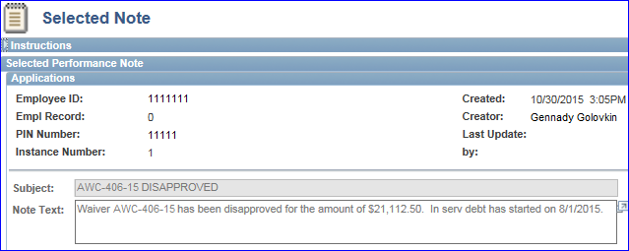
Direct Access NOTEPAD ENTRY
7
Notes:
Slide 15 – Matt
Direct Access documents Waivers and their approvals/disapprovals. To locate the information for your member you should access ELEMENT ASSIGNMENT BY PAYEE under the Pay Processing Shortcuts, click on IN SRVC DEBT and click on the NOTEPAD. You should find something similar to the narrative description now appearing on your screen. Admittedly, this is a bit cryptic but the member should receive more detailed information through the mail.

Slide 16
One Final Distinction
7
Waiver:
Debt deductions continue
Remission:
Debt deductions Stop
Notes:
Slide 16 – Matt
One final distinction, the submission of a waiver will not stop a debt deductions from your pay.
A Remission will halt debt deductions until CG-1332 responds. In both cases, once PPC receives the response, your debt and it’s attendant-deductions will be altered accordingly.
Now, let’s take another quick poll…SANDI WILL SLIDE IT OVER
Poll: Have you ever seen a debt waiver get approved?
Choices: Not once in my entire career.
Yes, I’ve seen a unicorn.
Ok, thanks for your responses.

Slide 17
Liquidation Schedules
6
Less than $749.99 - 15% of disposable (30 days) earnings
More than $750.00 - 15% of disposable (60 days) earnings
Notes:
Slide 17 – Matt
Now, let me briefly address Number 6, the Liquidation Schedules…..
If your debt is less than 749.99 you are required to repay the debt at 15% of your disposable income and this will begin a minimum of 30 days later.
If your debt is higher it will also be repaid at 15% of your disposable income but at a minimum of 60 days later.

Slide 18
Request for Change
6
CO’s Approval
10% minimum
Notes:
Slide 18 – Matt
Should you request an alteration to this schedule, you must first receive your Commanding Officer’s approval and you should remember that it will result in, at best, a liquidation schedule conforming to 10% of your disposable earnings which is defined in the Pay Manual, Chapters 7 and 11.
Well, that concludes my portion of today’s presentation so let me hand you off to the one and only, Charles Bartocci.

Slide 19
PPC vs. System Generated
5
System Generated – NO Notes
PPC Generated – Notes
Notes:
Slide 19 – Charlie
Hello again…Number 5 on our Top 10 list. We are going to outline the difference in PPC manually created debts in Direct Access vs when DA automatically creates a debt.
(click) Speaking to the administration folks here…In as few words as possible…System Generated debts will have NO documented “notes” in direct access.
(click) and when PPC manually records a debt in DA, there will be specific information…when and what happened that caused the debt. We will show you both examples…

Slide 20
PPC vs. System Generated
5
Notes:
Slide 20 – Charlie
(click) For SPO personnel and members that hold the CGHRSVW role, you select the Element Assignment by Payee (EABP) link in the Pay Processing Shortcuts

Slide 21
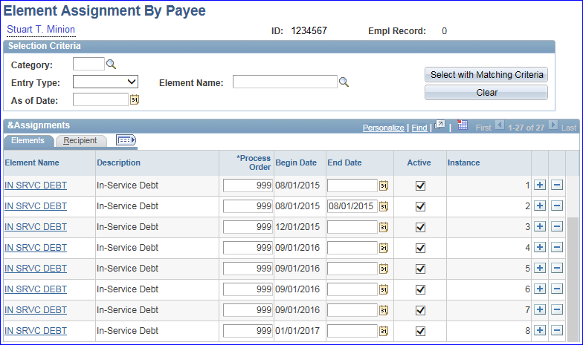
PPC vs. System Generated
5
Notes:
Slide 21 – Charlie
(click) Enter the member’s employee ID and search. Scroll down to the bottom of the page to find all the in service debts recorded. In just a few minutes Maddy will walk through how to read and understand the information for EABP.
(click) We are now going to take a look at a couple of debts.

Slide 22
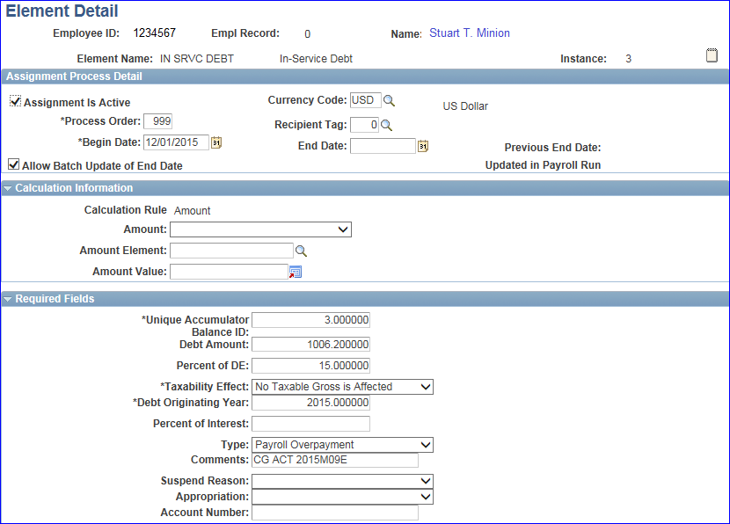
System Generated
5
Notes:
Slide 22 - Charlie
(click) First let’s look at debt for $1006.20 recorded as instance 3. This is a System Generated Debt.
(click) Notice that the “note pad” does not have any visual lines…that tells us there are no “notes” recorded for this debt. The comments tells us that we must research further by going to the member’s 2015 September end-month pay calculations. Maddy will walk us through this process in a few minutes.

Slide 23
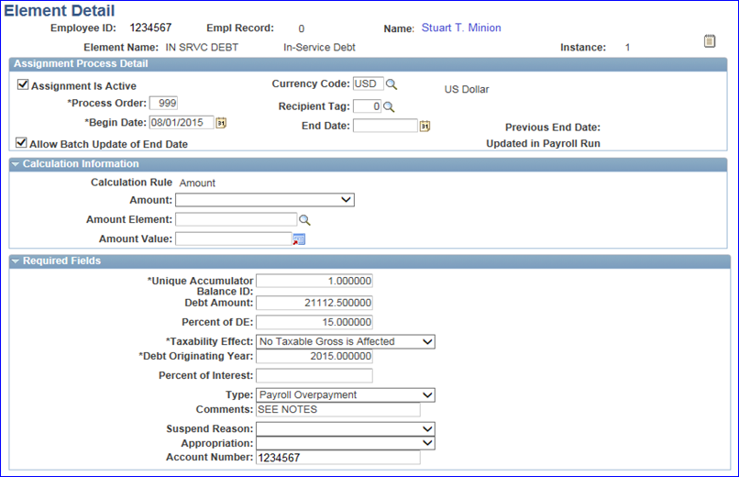
Active Duty
PPC Generated
5
Notes:
Slide 23 – Charlie
(click) Now let’s take a look at Instance 1 debt for…yep $21,112.50!!!
(click) Notice that the “note pay” has visual lines indicating there are recorded notes concerning this debt, and the Comments tells us to see the notes. Click on the Note Pad icon to open the note pad.

Slide 24
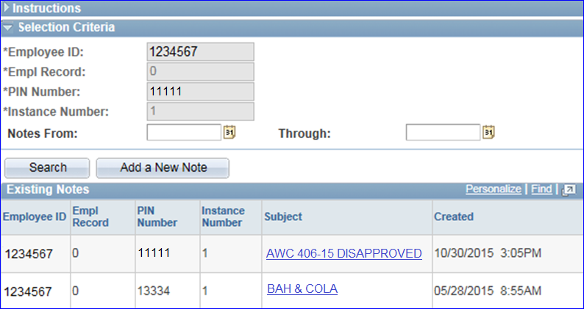
Active Duty
PPC Generated
5
Notes:
Slide 24 – Charlie
(click) In this example, there are two notes recorded one dated 5/28 and the other 10/30. You need to click on each separately to view the notes. Matt had previously shown the 10/30 note where the member was denied a waiver for the debt.

Slide 25
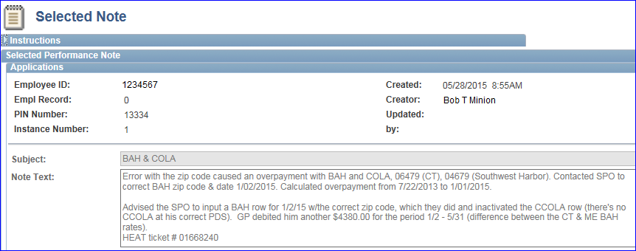
Active Duty
PPC Generated
5
Notes:
Slide 25 – Charlie
(click) The note dated 5/28 gives specific information on how the debt occurred. (read note or pause for them to read it)

Slide 26
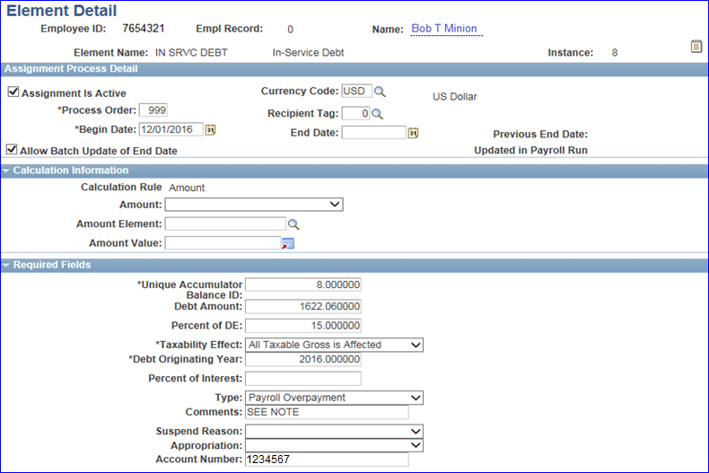
Reservist
PPC Generated
5
Notes:
Slide 26 – Charlie
(click) OK…We can’t talk about debts without talking about Reservists…Reservists incur debts mostly due to untimely processing of their AD orders. In this example we will look at Instance 8 debt in the amount of $1622.06.
(click) Since this is a PPC manually created debt, there are notes available. Click the Note Pad.

Slide 27
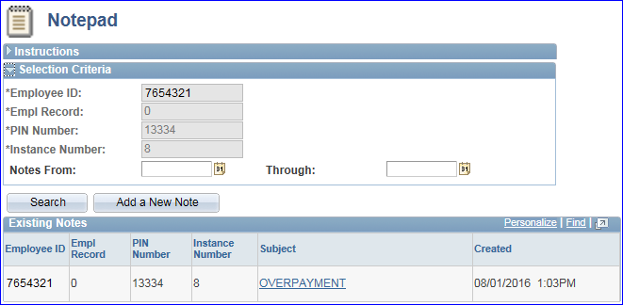
Reservist
PPC Generated
5
Notes:
Slide 27 – Charlie
(click) The Note Pad screen tells us the debt was an overpayment but nothing specific. Click the Overpayment link.
(click) The selected note gives full details on this member’s overpayment that occurred because the members orders end date did not process and they continued to receive pay/allowances through the mid-month pay cycle.
OK…as promised, I’m going to turn you over to Maddy who will get down in the trenches concerning EABP and Pay Calculations….Maddy educate us….

Slide 28
E.A.B.P.
4
Notes:
Slide 28 – Maddy
Thanks, Charlie! Welcome back, everyone! Number 4 for our Top 10 Tuesday is the Element Assignment by Payee or EABP, located on the Pay Processing Shortcuts pagelet. That’s always the best place to start when researching or troubleshooting a debt. As you see on the screen, EABP shows pay elements like allotments, dental deductions, loans, debts, FSA, etc.

Slide 29
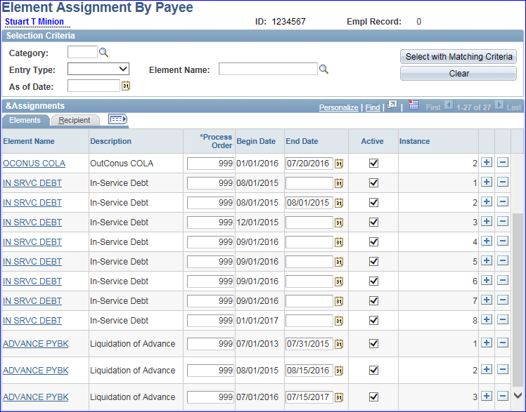
E.A.B.P.
4
Notes:
Slide 29 – Maddy
All Action Requests as well as any debts will be displayed for the member including the Begin and End Dates. The Instance number represents what sequence the transactions were submitted. Instance numbers are a big factor for both Pay Corrections and In-Service Debts. Notice this member has 8 debts. The system will only deduct for one debt at a time. Charlie already touched on a few of these, (CLICK) but I’m going to dive a little deeper into Instance #3.

Slide 30
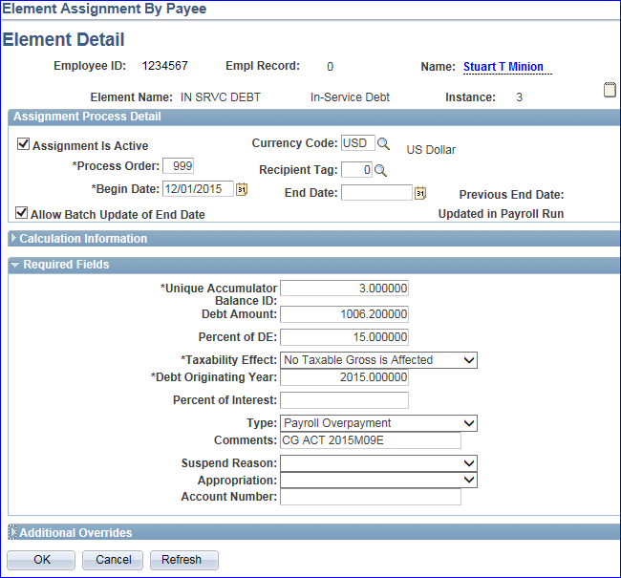
E.A.B.P.
4
Notes:
Slide 30 – Maddy
The instance number and the Unique Accumulator will always match. That is what identifies each debt in the Accumulators (which Sandi will show you in a few moments).
(CLICK) The Debt Amount is the total for this In-service debt. This debt amount is $1006.20.
(CLICK) The Percent of DE is scheduled to start collecting the debt at 15% of the member’s disposable earnings.
(CLICK) The Taxability Effect says that this debt has no effect on taxable income for the year.
(CLICK) The Debt Originating Year for this debt was in 2015.
(CLICK) The Debt Type in this case is a System Generated Payroll Overpayment.
(CLICK) The Comments shows the pay calendar when the debt was established. For this one, it is showing End-Month September of 2015. Notice there are no lines on the notepad, which as Charlie explained is another indicator that this is a system-generated debt vice a PPC manually created debt. Now that we know which calendar we need, we can dive into our next topic…

Slide 31
Pay Calculation Results
3
Notes:
Slide 31 – Maddy
Number 3 for our Top 10 Tuesday is the Pay Calculation Results. It is also found on the Pay Processing Shortcuts pagelet and is where you should be reviewing all earnings, deductions and accumulators. We need to go here to review the calendar when the debt was originally built.

Slide 32
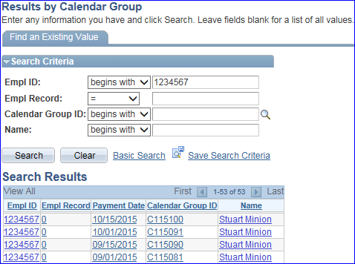
Pay Calculation Results
3
Notes:
Slide 32 – Maddy
Click on the Calendar for End Month September of 2015.

Slide 33
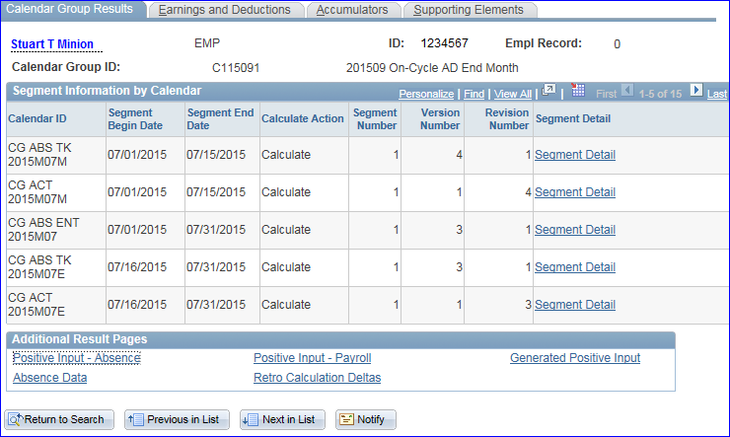
Pay Calculation Results
3
Notes:
Slide 33 – Maddy
Always click the Earnings and Deductions tab first.

Slide 34
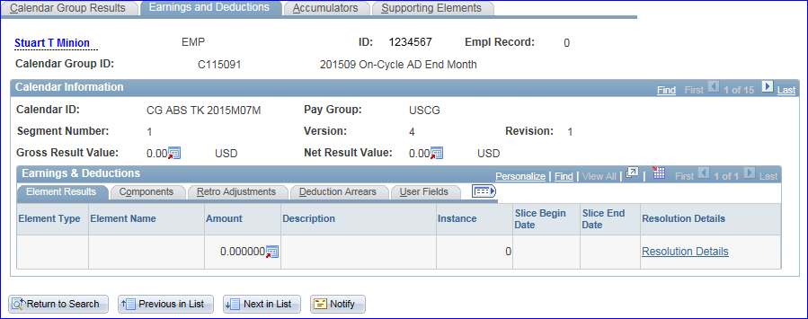
Pay Calculation Results
3
Notes:
Slide 34 – Maddy
Now click Last.

Slide 35
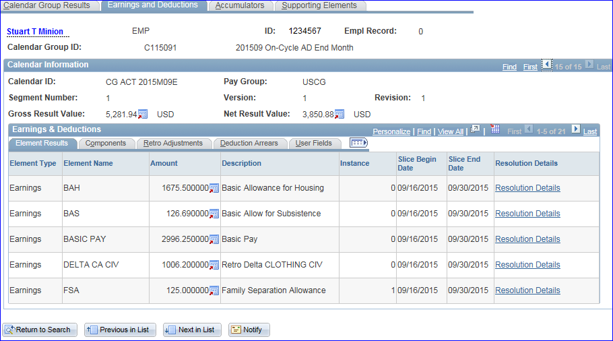
Pay Calculation Results
3
Notes:
Slide 35 – Maddy
Click View All.

Slide 36
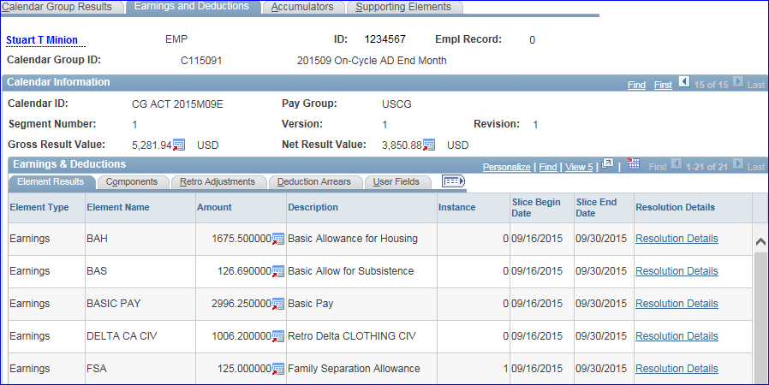
Pay Calculation Results
3
Notes:
Slide 36 – Maddy
Anytime you see the word DELTA before an earning or deduction, it means that something happened retroactively. Notice the amount of $1006.20 is the exact same amount we saw for the instance #3 debt. So now we can tell the member that his debt is for a retroactive civilian clothing allowance. That’s all I have for today…bring us home, Sandi!

Slide 37
2
Debt Balances
E.A.B.P.
Pay Calculation Results
Accumulators
-In-Service Debt Deduction Bal
-Advance Paybacks
-SGLI Arrears
Notes:
Slide 37 – Sandi
Greetings everyone! I am here today with number 2 and how to find, read and understand debt balances. SPO and admin shops are always helping members with this topic since they all work so differently in DA. Maddy already went into detail about this first step but it is the most important. (CLICK) The main reason for going to the EABP is to get the instance number for the Advance payback or In-service Debt that a member is questioning. Next go to the (CLICK) Pay Calculation Results link, find the most recent calendar, and (CLICK) the accumulators tab. The next few slides will show (CLICK) how the in-service debts work and appear (CLICK), how Advances that are being paid back work and appear and (CLICK) how to tell whether or not a member has an SGLI debt or credit in the system. (CLICK)

Slide 38
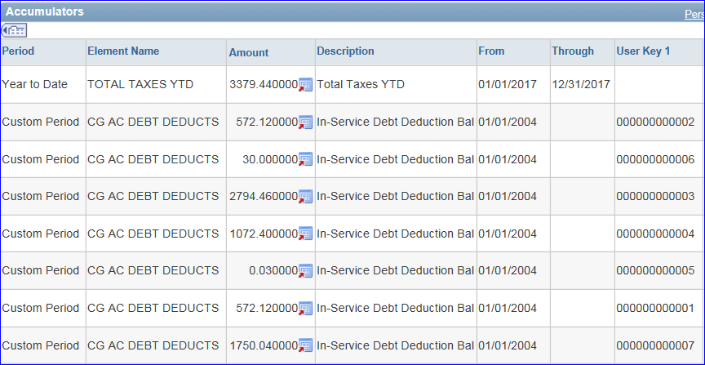
2
Debt Balances
Notes:
Slide 38 – Sandi
This screen shot shows the importance of knowing the instance number when researching a debt in the pay calculation results. To see these numbers, you have to click (CLICK) the Expand All Icon to see the User Key 1 column. A member may have several debts showing in this section and I will explain more about why in the next few slides. (CLICK) Also note that the order is random and may not appear in this order each time you look through each pay calendar. (CLICK)

Slide 39
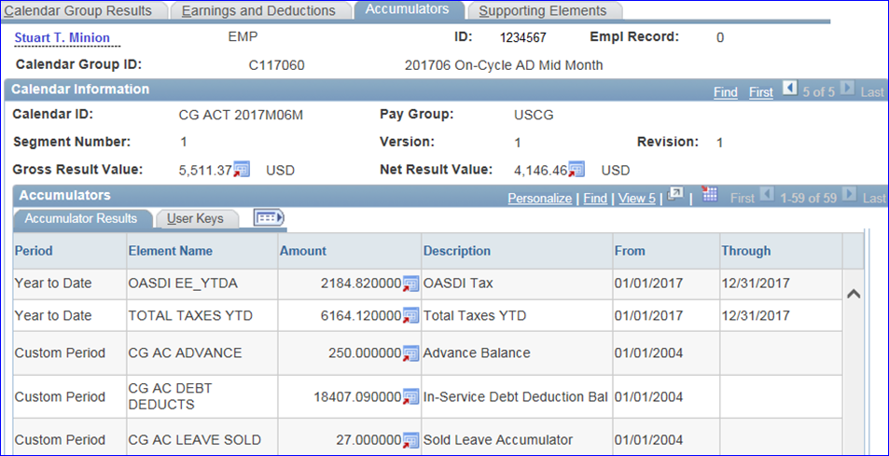
2
Debt Balances
Notes:
Slide 39 – Sandi
In this June mid-month calendar, our member’s (CLICK) Accumulators tab Custom Period section shows (CLICK) an Advance Balance of $250.00 and an In-Service Debt Deduction Balance of over $18,000.00. This is an example of the difference between how an Advance is paid in full verses how an overpayment or debt is paid in full in Direct Access. Advances DECREASE in this section and show a remaining balance owed. (CLICK)

Slide 40
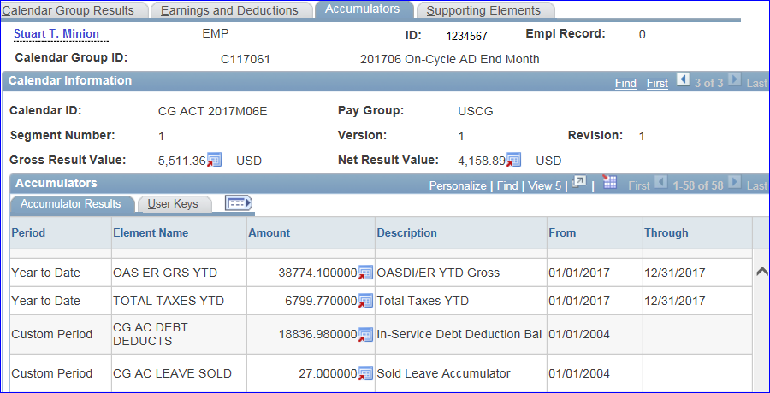
2
Debt Balances
Notes:
Slide 40 – Sandi
Notice on this end month June calendar that the Advance payback no longer appears and that the (CLICK) In-service debt deduction balance is INCREASING. Because it is a DEDUCTION balance, it will continue to increase until the entire $21,112.50 debt is collected in full. Since it is not a zero balance like our Advance has now, it will remain in this custom period section forever. (CLICK)

Slide 41
2
Debt Balances
Cumulative amounts for SGLI, TSGLI, FSGLI display in the Custom Period.
Positive Amounts = arrears
Notes:
Slide 41 – Sandi
Now we are going to look at insurance balances. Until SGLI is no longer being deducted from pay in Direct Access, (CLICK) cumulative amounts for SGLI, TSGLI, FSGLI will display in the Accumulators tab of the Pay Calculation Results Custom Period section as well. (CLICK)
This member’s Accumulator results shows how the element names appear. In this example the amount is a positive number. Does everyone know what that means??? (WAIT) Well it means that (CLICK) this member is in arrears these amounts and from the looks of it, it covers 2 months of pay deductions. (CLICK)

Slide 42
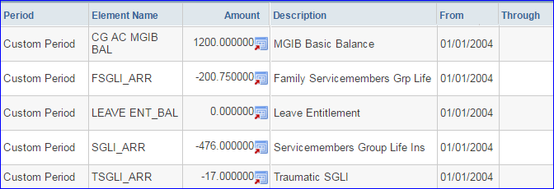
2
Debt Balances
Negative Amounts = prepayment credit
Notes:
Slide 42 – Sandi
This next example shows a (CLICK) prepayment made by check or credit card to PPC to cover several months of not drilling. As the member does not drill, (CLICK) these amounts will move toward $0.00. It is important to note that (CLICK) negative amounts mean the member has a credit. IF the member does happen to drill during this time frame, the insurance premium will be deducted from the members current PAY and NOT this credit line. Sometimes refunds are owed if a member separates from the Coast Guard before this credit is used in full. (CLICK)

Slide 43
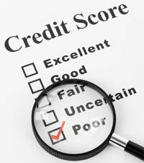
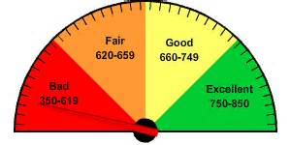
2
Debt Balances
Upon Separation
The Debt Collection Process:
Separations Team
Finance Center
Treasury Dept
Notes:
Slide 43 – Sandi
And lastly, I am going to cover the (CLICK) debt collection process when a member separates with a debt balance still owed. The (CLICK) separations team here at PPC uses all available remaining pay to offset the debt amount still owed. If you are aware of this debt and if caught timely, you, the member has the opportunity to call PPC and make a credit card payment before the debt is sent to the Finance Center for further collection processes. Once (CLICK) Fincen gets the notification for a debt from the SEPS team, they will notify you and try to collect the debt within a 90 day period and they do not take payment plans!! Also during this time, Fincen adds penalties, fees, and interest to the debt until it is paid in full. Here is where it gets really ugly. On day 91, if the debt is not collected in full, the remainder is forwarded (CLICK) to the United States Treasury Department for collection. This is a credit history score destroyer AND Treasury charges an immediate 25% against the principle amount when they receive it. So a $500.00 debt is now up to $625.00 not including all of the additional penalties, fees and interest that Treasury charges every month until it is collected in full. Oh and one other thing-as of 2010 there is no statute of limitations for collecting on government owed debts. I have seen a lot of bankruptcy claims in my time at PPC because of large debts owed to the CG. So (CLICK) to keep from ruining your credit after separating, talk to your SPO and know what needs to be done to make sure you are not overpaid, or pay off your debt ASAP. (CLICK)

Slide 44
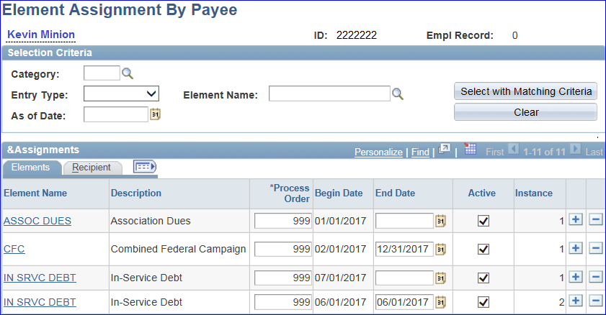
Troubleshooting Debts
1
Notes:
Slide 44 – Sandi
Here we are finally at Number 1 and I am going to troubleshoot a member’s payslip from start to finish. I will be reiterating some of what Charlie and Maddy already talked about in previous numbers but this will be a great refresher for all the parts that a debt touches in Direct Access. Let’s start (CLICK) here with the most current remarks section on a payslip showing our member has a (CLICK) $614.10 debt. This is great information on the payslip but it does not explain what the debt is for on the payslip. Like Matt discussed previously, since the amount is under $1,000.00, they received no notification or explanation on this debt by email and they want to know what this debt is for. Like I said earlier, first and always foremost I will go to (CLICK) the members EABP and find an open (CLICK) EABP row. Next I will click (CLICK) on the In Serv Debt link to research more information about this debt. (CLICK)

Slide 45
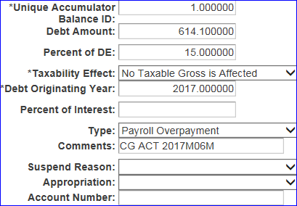
Troubleshooting Debts
1
Notes:
Slide 45 – Sandi
When the link opens we scroll to the Required Fields section to make sure that it is the (CLICK) correct debt amount and to see if MAS or the system has provided any (CLICK) information in the Comments Field. Since this particular comment gives us the mid-month June calendar to look at, we know that it must be a system generated debt and we will have to go to the Pay Calculation Results to find out what this debt is for. (CLICK)

Slide 46
Troubleshooting Debts
1
Notes:
Slide 46 – Sandi
Next go the Pay Calculation Results link and (CLICK) select the mid-month June calendar that was indicated in the EABP for this debt. (CLICK)

Slide 47
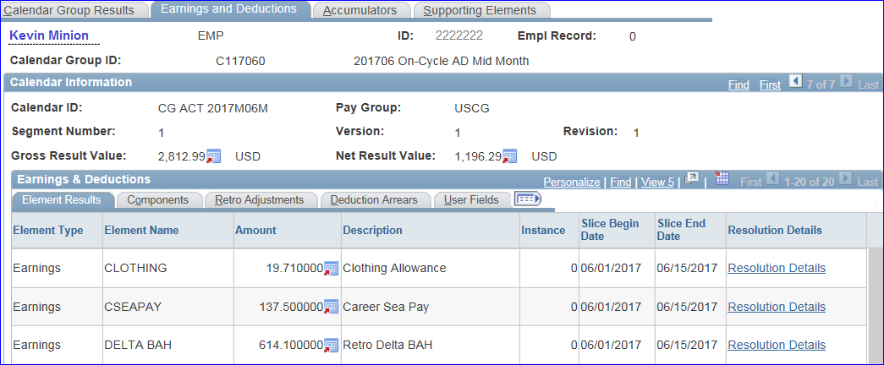
Troubleshooting Debts
1
Notes:
Slide 47 – Sandi
And here is the best 1, 2, 3, 4 explanation for finding what you need in any pay calendar that I once overheard from a Yeoman in Customer Care. I am pretty sure Maddy used these steps as well when she talked about it earlier.
#1. (CLICK) Click the Earnings and Deductions Tab, #2. (CLICK) click Last #3. (CLICK) Click View All and #4. (CLICK) scroll. You will notice that the debt shows up as a (CLICK) Retro Delta in the Earnings and Deductions tab and in this case it is for BAH. (CLICK)

Slide 48
Troubleshooting Debts
1
Notes:
Slide 48 – Sandi
While still in the Earnings and Deductions tab, click (CLICK) on the Retro Adjustments tab and then on the (CLICK) Adjustment Detail link next to the correct debt amount. The (CLICK) Delta Details page will appear with the information of the breakdown BUT you may need to click (CLICK) view all again to see the full breakdown. (CLICK)

Slide 49
Troubleshooting Debts
1
Notes:
Slide 49 – Sandi
This will then show all the (CLICK) calendars that were affected by this adjustment and the (CLICK) amounts that were affected in each calendar. Sometimes the detail page will only show one affected calendar and sometimes it will show many. Either way, the total of all the calendars listed (CLICK) should add up to the full debt amount. (CLICK)

Slide 50
Troubleshooting Debts
1
Notes:
Slide 50 – Sandi
Since according to the members payslip the total amount due was less than the full amount, more information will be needed if the member wants to pay the debt in full via Credit card or check. In this case I need to click on the most (CLICK) recent calendar for the member. Again the same 4 steps are needed when researching a debt in the (CLICK) Accumulator tab. #1 (CLICK) click Accumulators tab, #2 (CLICK) click last, #3 (CLICK) click View All, and #4 scroll to the custom period section. (CLICK)

Slide 51
Troubleshooting Debts
1
$614.10
-$192.51
=$421.59
Notes:
Slide 51 – Sandi
This section shows what monies have been collected on this debt so far. Remember that In-service debts count up in the accumulators section until collected in full. Now we will have to get our handy dandy Phone/calculators out and do some quick math. We will take our (CLICK) total debt amount owed, (CLICK) subtract the amount collected thus far in this calendar to get the (CLICK) remainder owed to the Coast Guard. Since this Payslip example was brought in timely, this amount matched the amount showing as owed on the payslip. (CLICK)

Slide 52
Troubleshooting Debts
1
Two Choices for paying the debt:
Collect over time
Pay now
Notes:
Slide 52 – Sandi
Once this information is known, (CLICK) the member has the choice of letting the debt (CLICK) collect over time from their pay OR calling (CLICK) PPC customer care to request the number for the contacts here at PPC that take checks, money orders and credit card information. Remember that no one wants to have a debt or cause someone to have a debt, especially if it is not their fault. And members make sure you are aware of your payslips and review them periodically to make sure all the information is correct (meaning addresses and dependent info and voluntary payroll deductions). (CLICK) When communications with your SPO, Admin shops and PPC occur, hopefully we can make this process a lot less stressful for everyone. That’s it for number one and now it is time for…
(CLICK)

Slide 53
Notes:
Slide 53 – Sandi Q & A
…Q&A. We want to make sure you that all your doubts or concerns are covered so start typing in any questions you may still have. And while you are typing in questions I am going to move this downloadable presentation onto the screen so you can click on it to download for future use and reference. And any questions that we can’t answer today will also be available along with this presentation on our webpage in the next few days.…

Slide 54
PPC-PF-PD@USCG.MIL
FEATURING THE PPC PROCEDURES &
DEVELOPMENT
STAFF
Notes:
Slide 54 – Mr. McElroy – Thank you for joining us here today for this edition of our monthly Top 10 Tuesday. Any unanswered questions will be addressed and posted as soon as possible on our P & D webpage so check back soon to find answers to today‘s questions as well as past month’s Q & A postings. We will also post the link for this recording so you can share it with your shipmates. This concludes the session for today, have a great Coast Guard day!

